Slide 1






Tech Startup
Presentation

Slide 2

“ Tech Start Up”
TEAM MEMBERS:
Sania Zahra
Amna Khan
Hadia Nabeel
Ayesha Siddiqa
Soha Kazmi
Minahil Umer
COURSE:
AICTL

Slide 3






Frontend Developer

Slide 4
Backened Developer

Slide 5
UI/UX Designer

Slide 6
Quality Assurance Tester

Slide 7
Deployment and Maintenance

Slide 8

Executive Summary
This project is a Tech Startup Website developed for the AICTL Lab semester project.
Represents an imaginary technology-based startup.
Built using HTML and CSS
Demonstrates
Website design skills
Documentation & presentation skills
Version control and publishing using GitHub

Slide 9

Project Objectives
Design a professional Tech Startup website.
Clearly represent startup services and features.
Apply HTML and CSS concepts practically.
Improve documentation and presentation skills.
Use GitHub for version control and website publishing.
Promote eco-friendly digital ecosystems
Present key sustainability using Excel

Slide 10
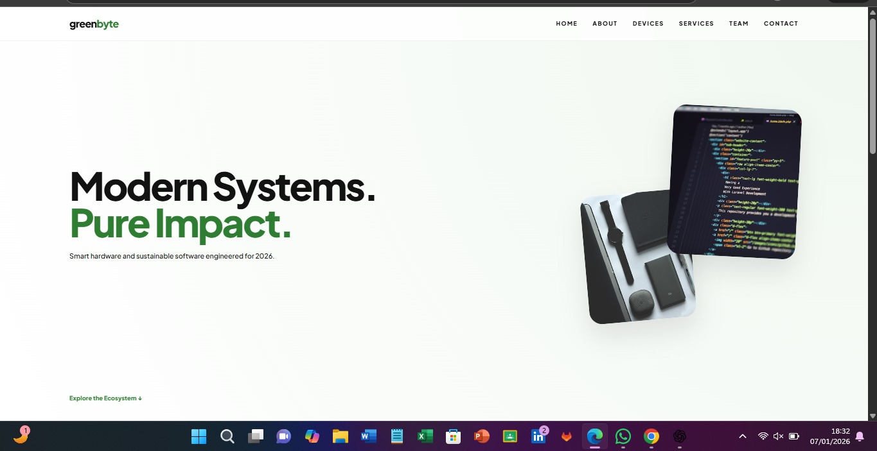

Website Demo: Home
Clean landing page with strong visual identity
Smooth scrolling and modern layout

Slide 11
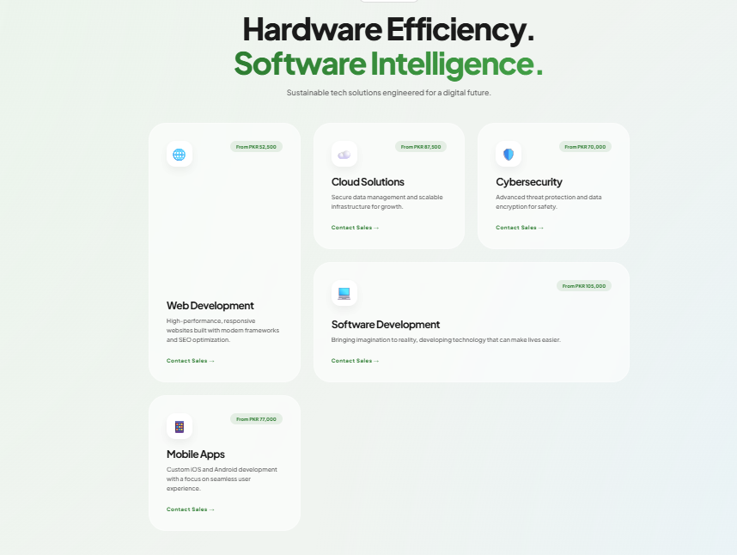

Website Demo: Product
Displays eco-friendly hardware & software
Clear call-to-action links
Card layout improves usability

Slide 12
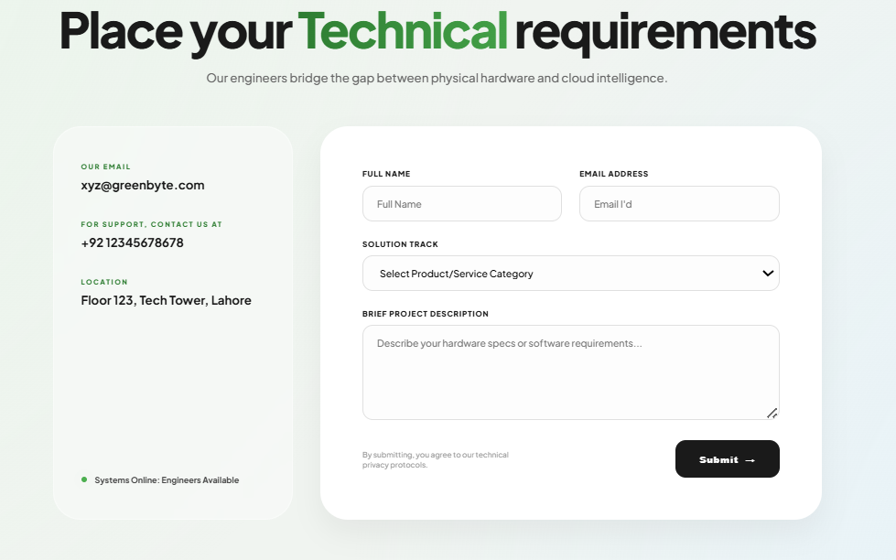

Website Demo: Contact
Simple contact interface
Improves user interaction
Essential for real-world deployment

Slide 13
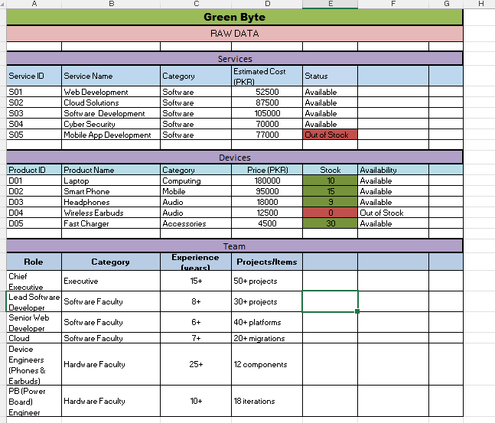

Excel Data Overview
Business metrics such as pricing, inventory, availability, and experience levels were evaluated
Excel formulas for calculating:
Average prices and costs
Inventory value before or after discounts:
Stock availability status

Slide 14

Design Decisions
Colour scheme: Green & neutral tones
Typography: Clean & modern fonts
Layout: grid and card-based sections
Responsive design: Works on different screens

Slide 15
Live Demo & GitHub
Live Website(GitHub Pages):
GitHub Repository:Repository Link
2025-CS-148 (Ayesha Siddiqa):Repository Link Live Link
2025-CS-132 (Hadia Nabeel): Repository Link Live Link
2025-CS-142(Soha Kazmi):Repository Link Live Link
2025-CS-153 (Amna Khan):Repository Link
2025-CS-126 (Manahil Umer): Repository Link
2025-CS-155 (Sania Zahra):Repository Link Live Link

Slide 16
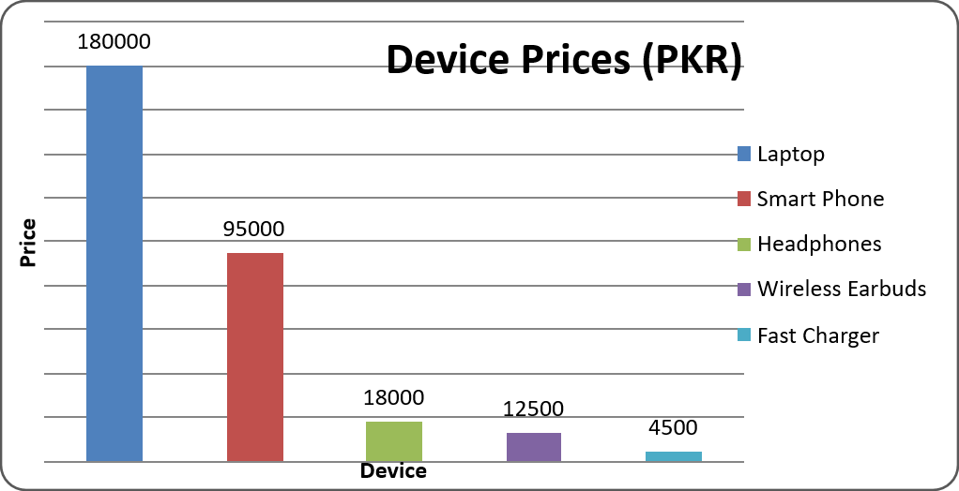
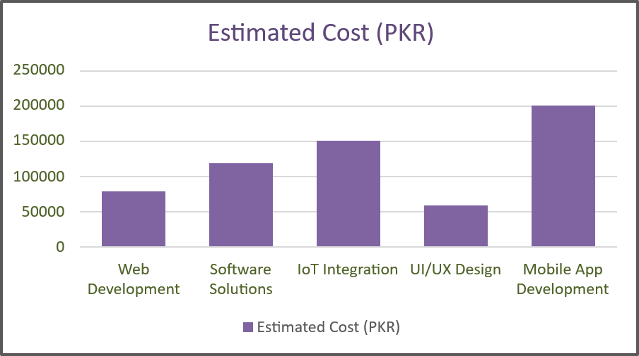
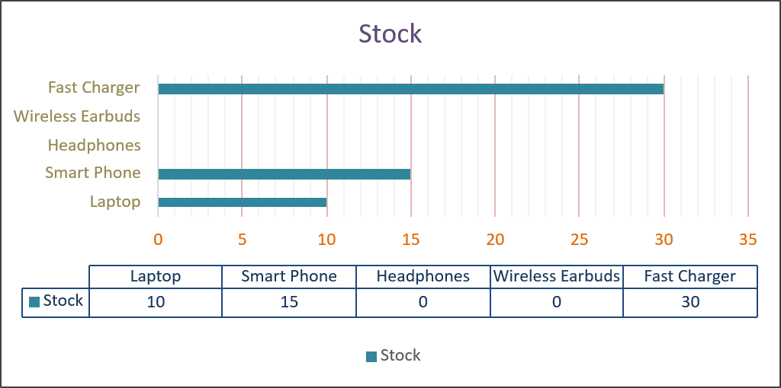
OUR SURVEY RESULTS:
Visual comparison of sustainability performance
Charts make data easy to understand
Supports the project’s eco-friendly mission

Slide 17
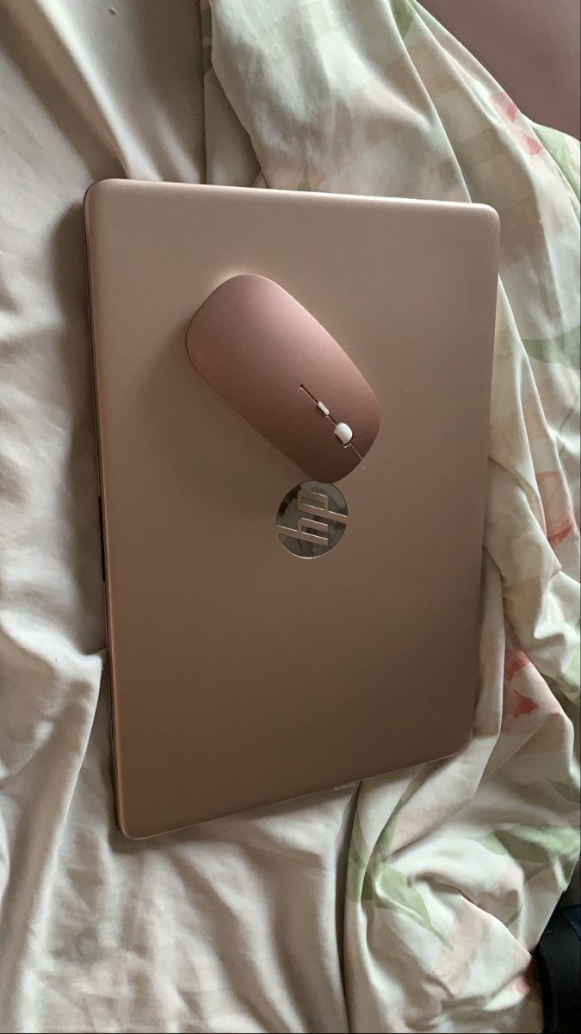
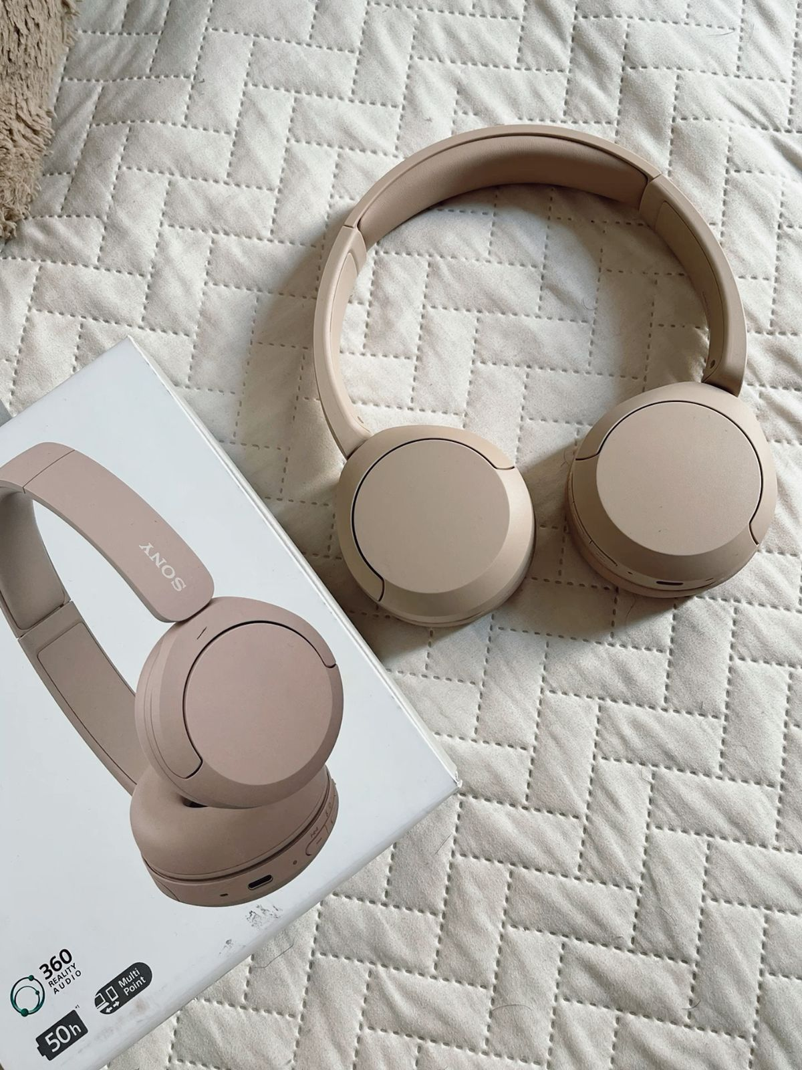
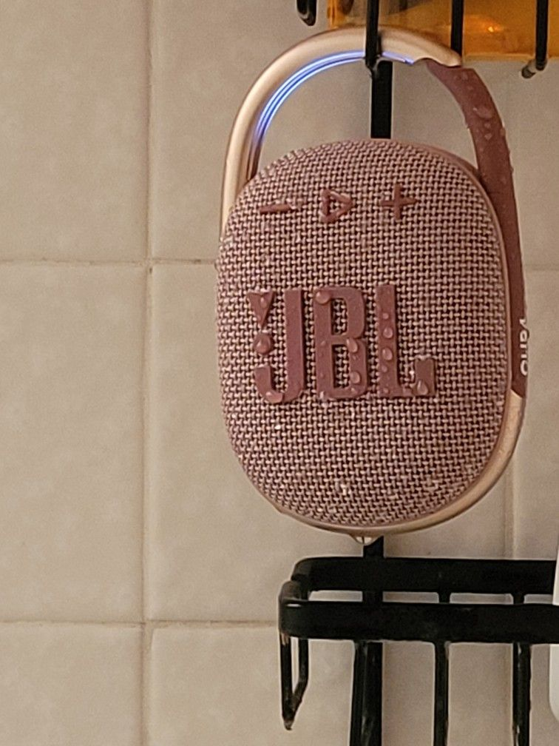
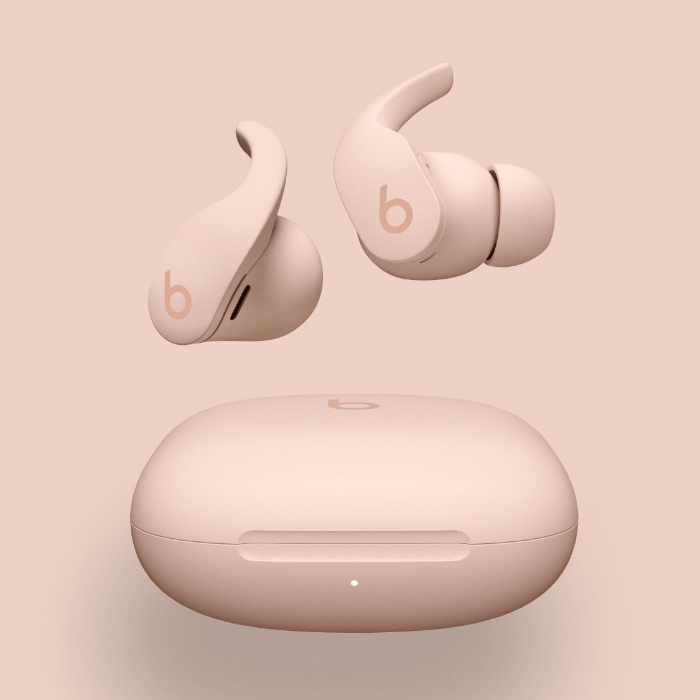
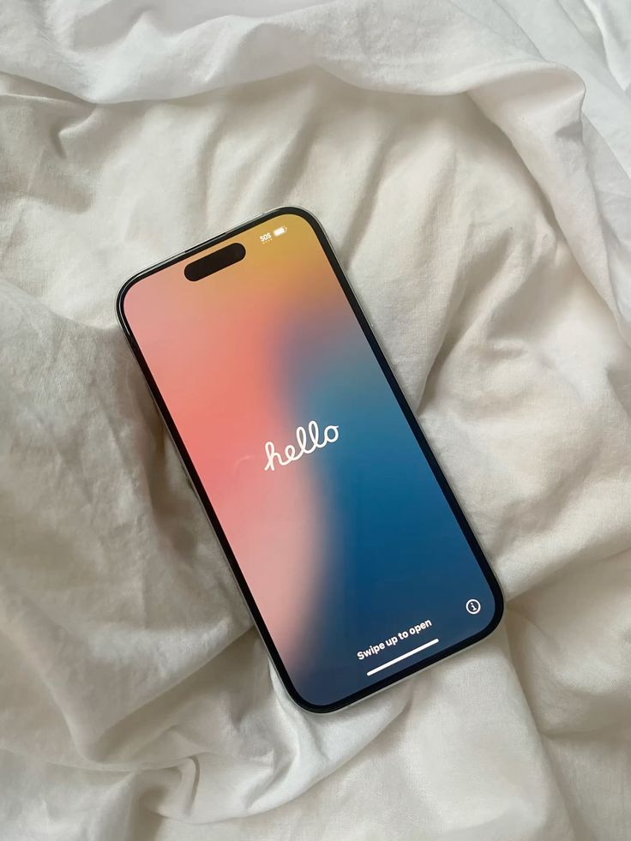
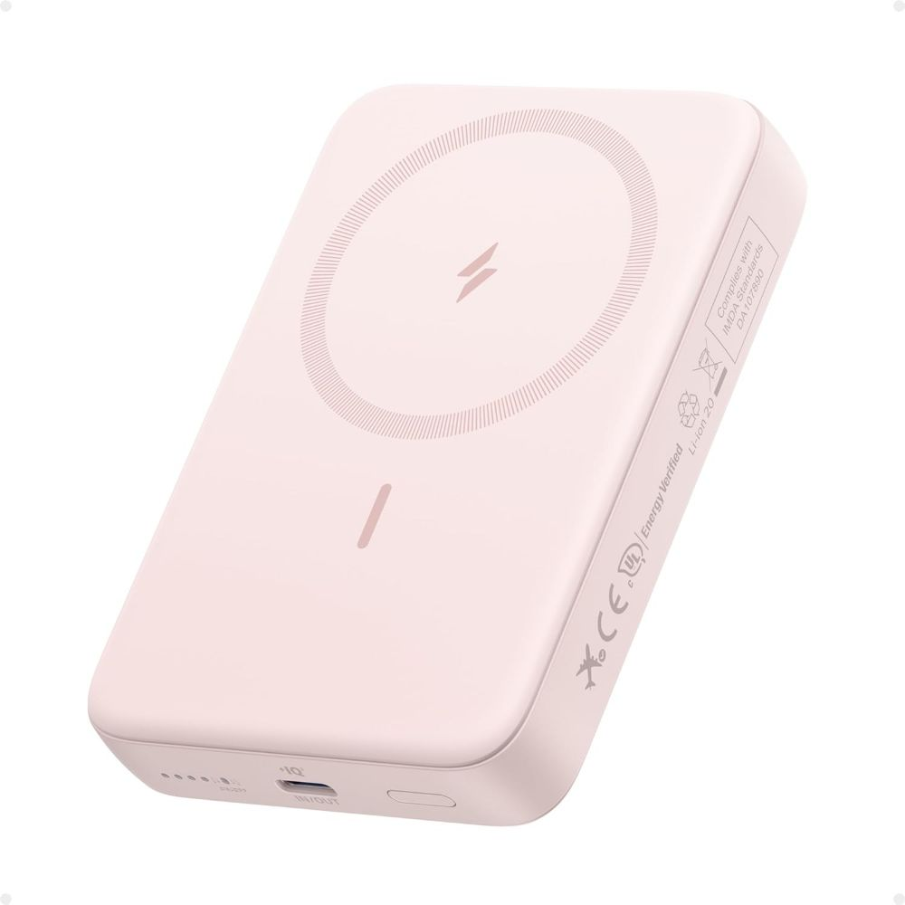
Few products available at website
Laptops
High-performance laptops for work and development

Slide 18
Head Phones
Noise-Cancelling studio quality sound

Slide 19
Bluetooth Speakers
Portable speakers with powerful bass and clarity

Slide 20
Wireless Earbuds
Compact sound with immersive audio

Slide 21
Smart Phones
Latest smartphones with powerful features

Slide 22
Power Banks
High-capacity portable charging solutions

